Slide 2
OLD TESTAMENT//structure

Slide 5
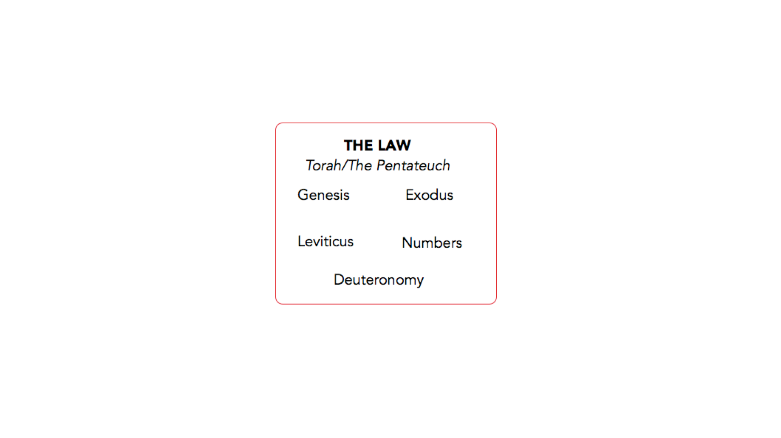

Slide 8
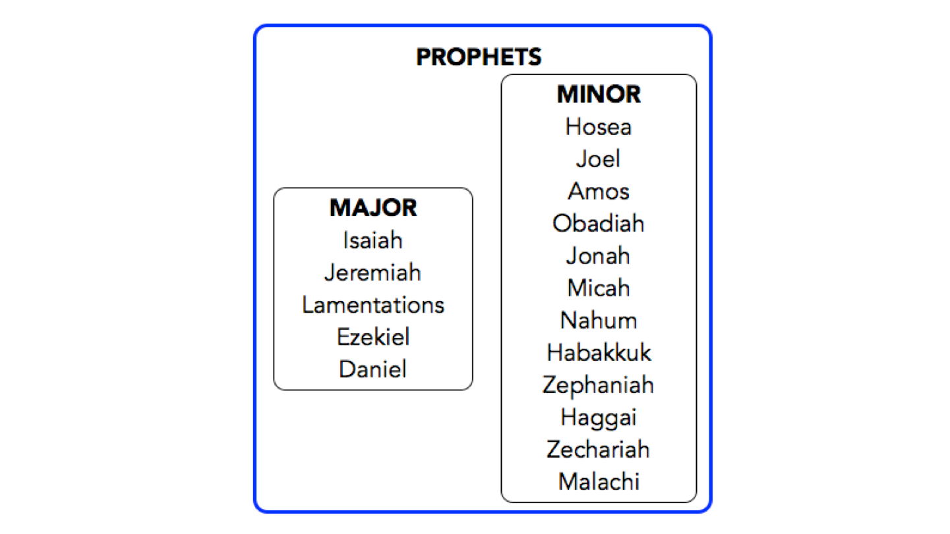

Slide 9
OLD TESTAMENT//STORY

Slide 10
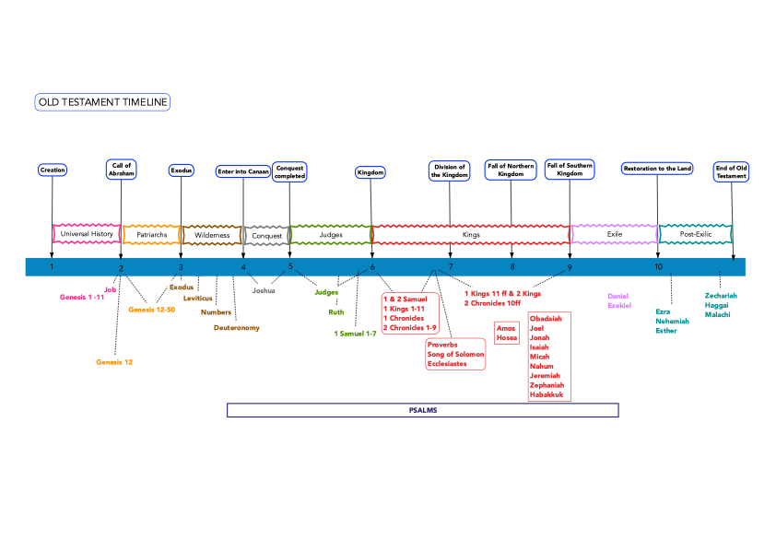

Slide 11
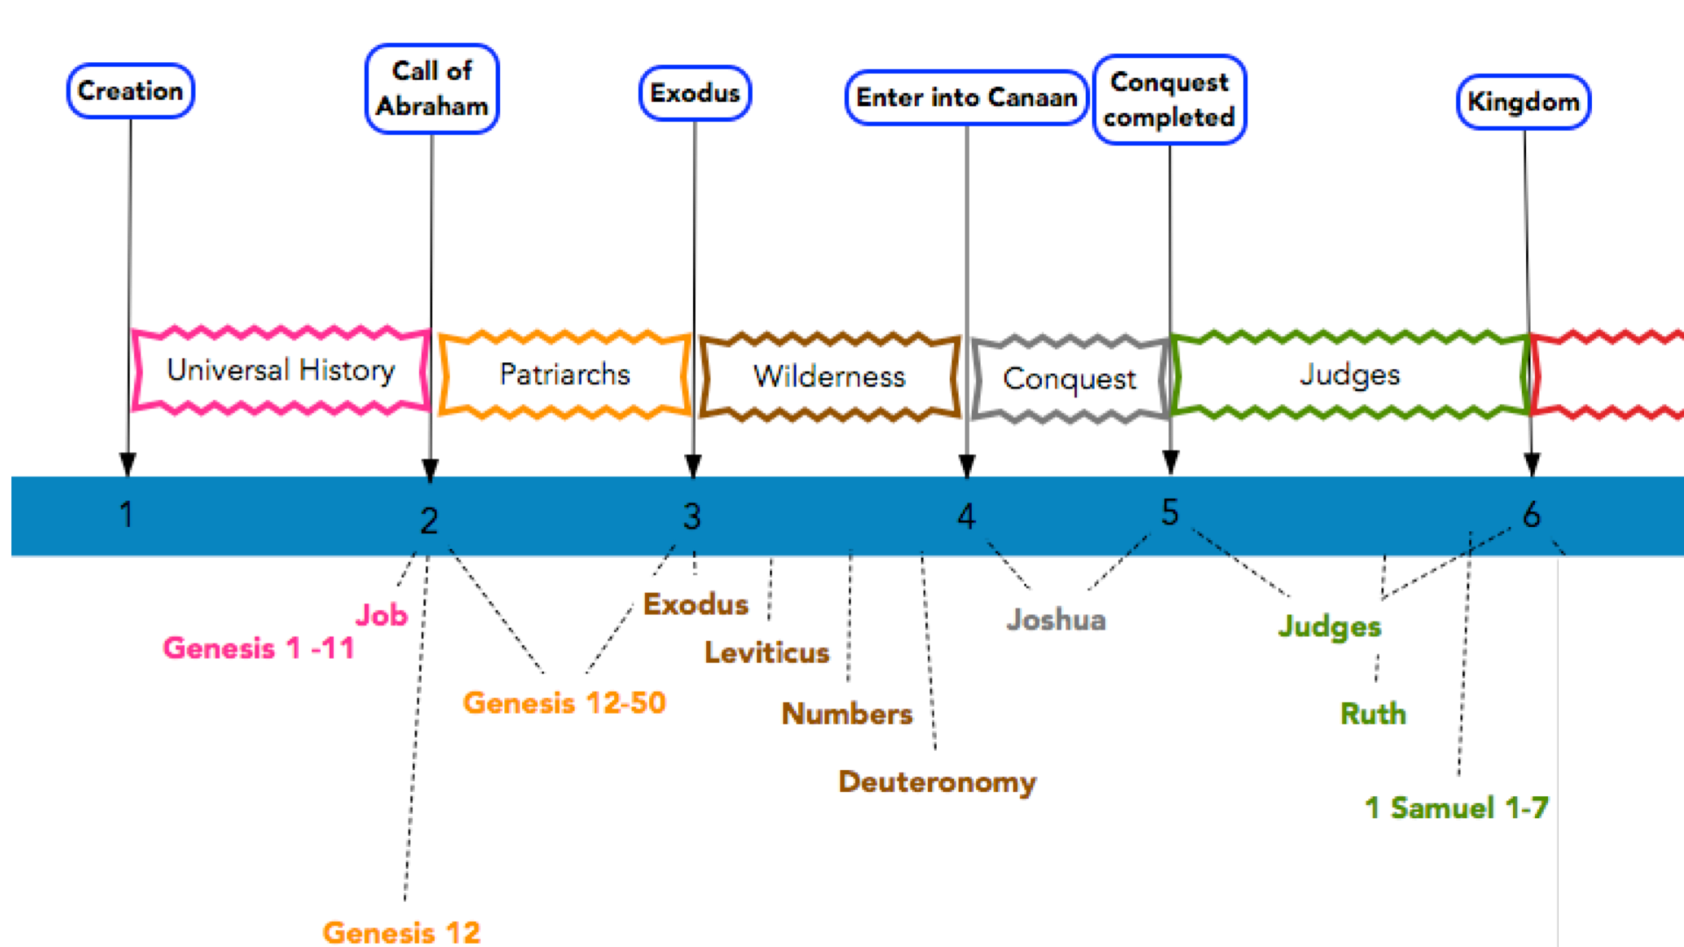

Slide 12
